Slide 1


NMIT
Docker Scout
ACR & K8s
Hands on presentation
20-JAN-2024

Slide 2
Content
Q & A
Demo
5
KillerCoda Lab setup
Docker Scout
4
3
Intro
2
1

Slide 3
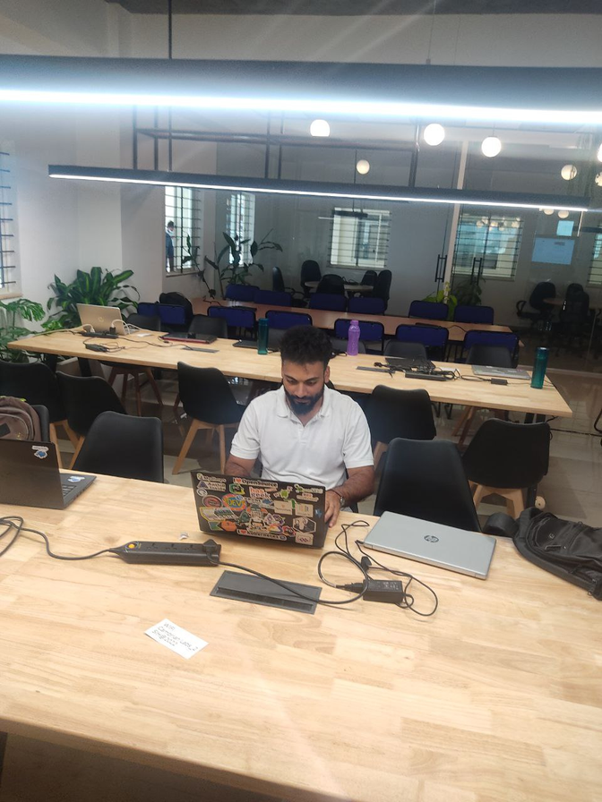



$whoami
Shubhendu Shubham
“sudo rm -rf / problems”
Threat Hunter & CTF Player
MS Certified Security Architect
Building Troubleshooter Club SaaS
Former Product Mentor @SIH 2022
Worked with Ministry of Edu & MyGov.in
Open-Source Contributor
Azure Developer community Leader
Azure Blogathon Winner 2021

Slide 4







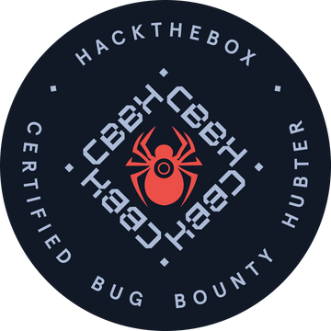





HALL OF FAME
CTF BADGES
CERTIFICATIONS
SC 100
AZ 305
AZ 104
ISC2

Slide 5
Docker Scout
Docker Scout is a container image scanning tool built within Docker Desktop as well as CLI with Shift-left approach mindset.
It lies on the top of the Docker ecosystem and helps developers to find container image vulnerabilities at the time of image build, thus helps organisation to ship secure entire supply chain.
It uses SBOM (S/W Bill of Material) with 17 + advisory DB

Slide 6



Slide 7



Game of Inner & Outer Loop Framework
Integrate
Test
Build
Outer Loop
Push
Code
Inner Loop
Deploy
Release
Test

Slide 8







docker
docker compose up
Define Services
Test Application
docker push
RUN
docker File
Source Control
Container Registry
Code commit

Slide 10


Slide 11
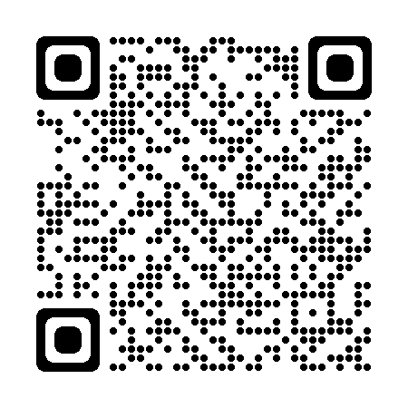
Thank You!

